Slide 1



HMR INSTITUTE OF TECHNOLOGY AND MANAGEMENT
TECHEXPO 2K25 PROJECT EXHIBITION
PROJECT TITLE - AI-Powered Personalized Study Planner
CATEGORY - Software
TEAM MEMBERS – Hitesh Manral , Ankit Singhal , Abhishek Chauhan, Nitin
COLLEGE NAME - HMR Institute of Technology and Management
DEPARTMENT – B.Tech Computer Science & Engineering

Slide 2
PROBLEM STATEMENT AND SOLUTION OVERVIEW
Purpose: To explain what problem you are solving and how your project provides a solution. Content:
Problem Statement:
Students struggle to create effective, personalized study schedules tailored to their goals, skill levels, and time constraints.
Manual planning is time-consuming and often lacks structure, leading to inefficiency and poor retention.
Solution Overview:
The AI-Powered Study Planner uses OpenAI's GPT-4 to generate customized learning schedules based on user inputs (learning goal, skill level, duration).
Integrates with Google Calendar for seamless scheduling and progress tracking.
Promotes personalized learning, productivity, and collaboration.

Slide 3
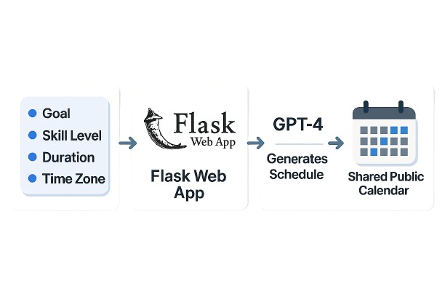
TECHNOLOGY STACK AND ARCHITECTURE
Purpose: To show the tools, technologies, and structure used to build the project.
Technology Stack:
Software: Python, Flask, OpenAI GPT-4 API, Google Calendar API
Platforms: Web application hosted on a server
Libraries: pandas, requests, gcalendar

Slide 4
IMPLEMENTATION AND PROTOTYPE
Purpose: To describe how the project was created and demonstrate its real-world functionality via a prototype.
Steps of Implementation:
Design: Created a user-friendly web interface for input collection.
Development: Integrated GPT-4 for schedule generation and Google Calendar API for event creation.
Testing: Validated schedule accuracy and calendar syncing across time zones.
Prototype Images/Demo:
Screenshot of the web interface with input form. link
Sample Google Calendar with generated schedule. link
Demo Video. link
Challenges & Solutions:
Challenge: Handling diverse user inputs for varied learning goals.
Solution: Fine-tuned GPT-4 prompts for consistent, detailed outputs.

Slide 5
IMPACT AND UNIQUENESS
Purpose: To highlight the project’s benefits and what makes it special.
Impact:
Personalized Learning: Tailored schedules enhance user engagement and retention.
Productivity: Saves time by automating planning and syncing with calendars.
Community: Public calendar sharing fosters collaboration and accountability.
Uniqueness:
Combines AI-driven personalization with seamless Google Calendar integration.
Adapts dynamically to user skill levels (beginner to advanced).
Cost-efficient, scalable solution for students and lifelong learners.

Slide 6
FUTURE SCOPE AND REFERENCES
Purpose: To share how the project can grow and provide research references.
Future Scope:
Add mobile app support for iOS/Android.
New open AI model use for faster response.
Add GUI based application for Mac/Window.
Integrate progress analytics with visualizations (e.g., completion rates).
Expand to support multiple languages and learning domains.
References:
OpenAI GPT-4 Documentation: https://platform.openai.com/docs
Google Calendar API: https://developers.google.com/calendar
GitHub Repository: https://github.com/arnitxvansh/HACKRPI23
Closing Line: "Empowering learners with AI-driven, personalized study plans for a smarter future!"

Slide 7
THANK YOU

